Slide 1
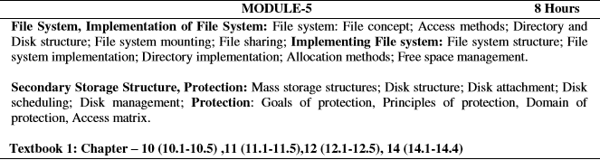
Module 5

Slide 2
File Concept
Contiguous logical address space
Types:
  Data
    numeric
    character
    binary
  Program

Slide 3
File Structure
None - sequence of words, bytes
Simple record structure
  Lines
  Fixed length
  Variable length
Complex Structures
  Formatted document
  Relocatable load file
Can simulate last two with first method by inserting appropriate control characters
Who decides:
  Operating system
  Program

Slide 4
File Attributes
Name – only information kept in human-readable form
Identifier – unique tag (number) identifies file within file system
Type – needed for systems that support different types
Location – pointer to file location on device
Size – current file size
Protection – controls who can do reading, writing, executing
Time, date, and user identification – data for protection, security, and usage monitoring
Information about files are kept in the directory structure, which is maintained on the disk

Slide 5
File Operations
File is an abstract data type
Create
Write
Read
Reposition within file
Delete
Truncate
Open(F_{i}) – search the directory structure on disk for entry F_{i}, and move the content of entry to memory
Close (F_{i}) – move the content of entry F_{i} in memory to directory structure on disk

Slide 6
Open Files
Several pieces of data are needed to manage open files:
  File pointer: pointer to last read/write location, per process that has the file open
  File-open count: counter of number of times a file is open – to allow removal of data from open-file table when last processes closes it
  Disk location of the file: cache of data access information
  Access rights: per-process access mode information
Open File Locking
Provided by some operating systems and file systems
Mediates access to a file
Mandatory or advisory:
  Mandatory – access is denied depending on locks held and requested
  Advisory – processes can find status of locks and decide what to do

Slide 7
File Locking Example – Java API
import java.io.*;
import java.nio.channels.*;
public class LockingExample {
public static final boolean EXCLUSIVE = false;
public static final boolean SHARED = true;
public static void main(String arsg[]) throws IOException {
FileLock sharedLock = null;
FileLock exclusiveLock = null;
try {
RandomAccessFile raf = new
RandomAccessFile("file.txt", "rw");
// get the channel for the file
FileChannel ch = raf.getChannel();
// this locks the first half of the file - exclusive
exclusiveLock = ch.lock(0, raf.length()/2,
EXCLUSIVE);
/** Now modify the data . . . */
// release the lock
exclusiveLock.release();
// this locks the second half of the file - shared
sharedLock = ch.lock(raf.length()/2+1, raf.length(), SHARED);
/** Now read the data . . . */
// release the lock
sharedLock.release();
} catch (java.io.IOException ioe) {
System.err.println(ioe);
}finally {
if (exclusiveLock != null)
exclusiveLock.release();
if (sharedLock != null)
sharedLock.release();
}
}
}

Slide 8
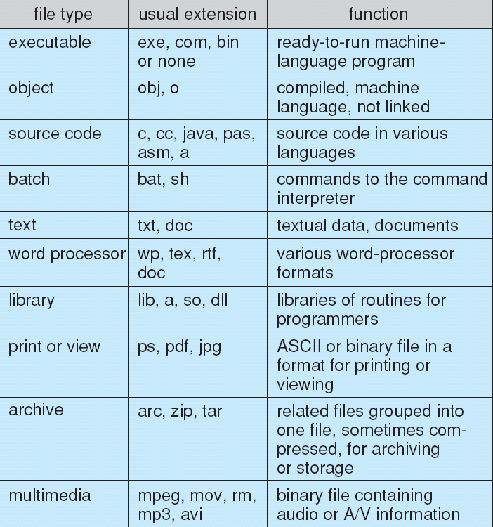
File Types – Name, Extension

Slide 9
Access Methods
Sequential Access
read next
write next
reset
no read after last write
(rewrite)
Direct Access
read n
write n
position to n
read next
write next
rewrite n
n = relative block number

Slide 10
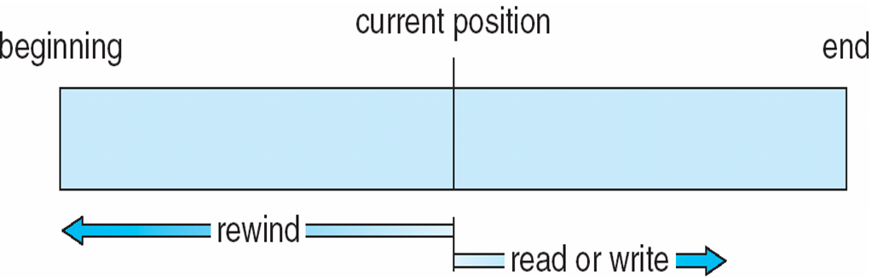
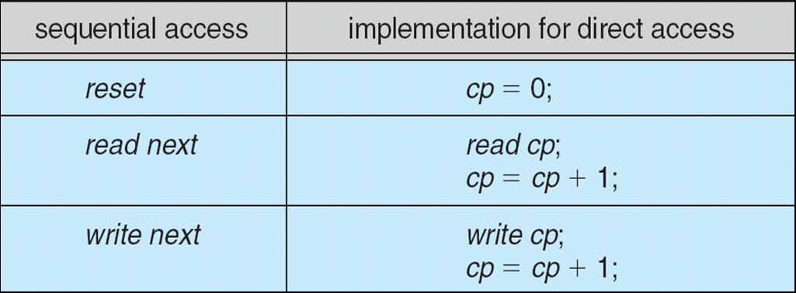
Sequential-access File
Simulation of Sequential Access on Direct-access File

Slide 11
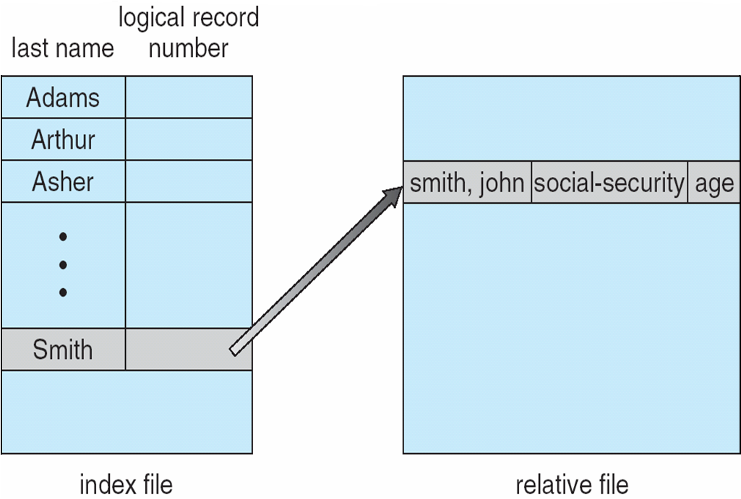
Example of Index and Relative Files

Slide 12
Directory Structure
A collection of nodes containing information about all files
Directory
Files
F 1
F 2
F 3
F 4
F n
Both the directory structure and the files reside on disk
Backups of these two structures are kept on tapes

Slide 13
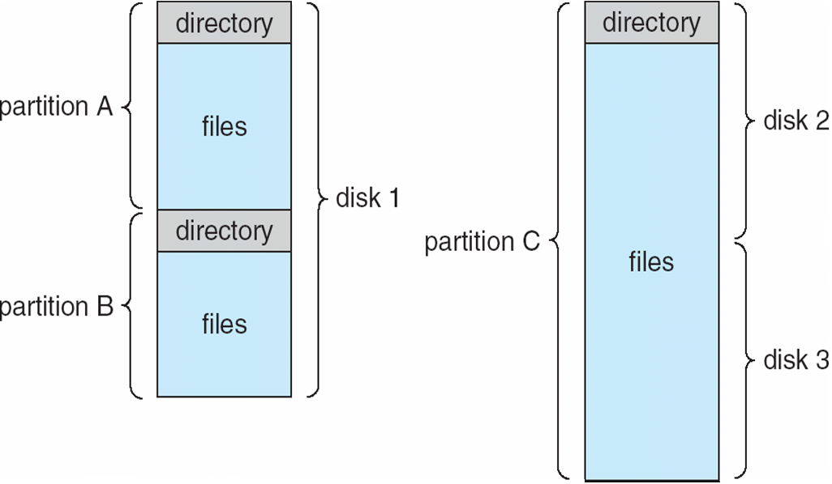
Disk Structure
Disk can be subdivided into partitions
Disks or partitions can be RAID protected against
failure
Disk or partition can be used raw – without a
file system, or formatted with a file system
Partitions also known as minidisks, slices
Entity containing file system known as a volume
Each volume containing file system also tracks that
file system’s info in device directory or volume table of contents
As well as general-purpose file systems there are
many special-purpose file systems, frequently all within
the same operating system or computer
A Typical File-system Organization

Slide 14
Operations Performed on Directory
Search for a file
Create a file
Delete a file
List a directory
Rename a file
Traverse the file system

Slide 15
Organize the Directory (Logically) to Obtain
Efficiency – locating a file quickly
Naming – convenient to users
  Two users can have same name for different files
  The same file can have several different names
Grouping – logical grouping of files by properties, (e.g., all Java programs, all games, …)

Slide 16
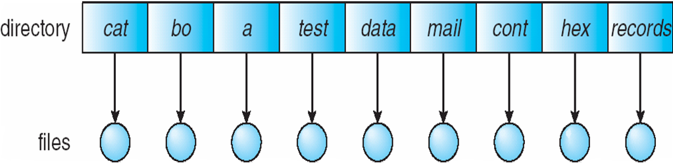
Single-Level Directory
A single directory for all users
Naming problem
Grouping problem

Slide 17
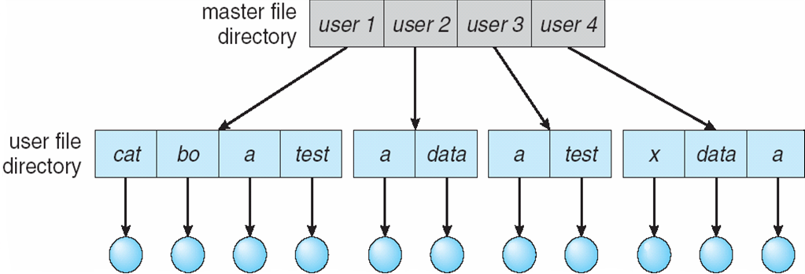
Two-Level Directory
Separate directory for each user
Path name
Can have the same file name for different user
Efficient searching
No grouping capability

Slide 18
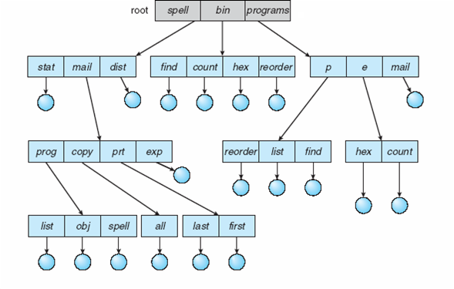
Tree-Structured Directories
Efficient searching
Grouping Capability
Current directory (working directory)
  cd /spell/mail/prog
  type list
Efficient searching
Grouping Capability
Current directory (working directory)
  cd /spell/mail/prog
  type list
mail
prog
copy
prt
exp
Count
Deleting “mail” ⇒ deleting the entire subtree rooted by “mail”

Slide 19
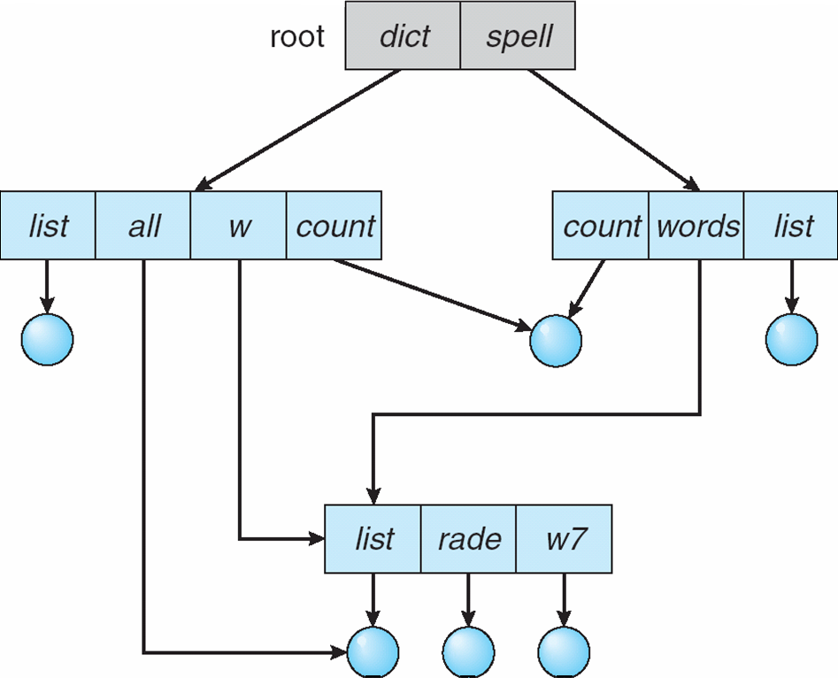
Acyclic-Graph Directories
Have shared subdirectories and files
Two different names (aliasing)
If dict deletes list ⇒ dangling pointer
Solutions:
  Backpointers, so we can delete all pointers
  Variable size records a problem
  Backpointers using a daisy chain organization
  Entry-hold-count solution
New directory entry type
  Link – another name (pointer) to an existing file
  Resolve the link – follow pointer to locate the file

Slide 20
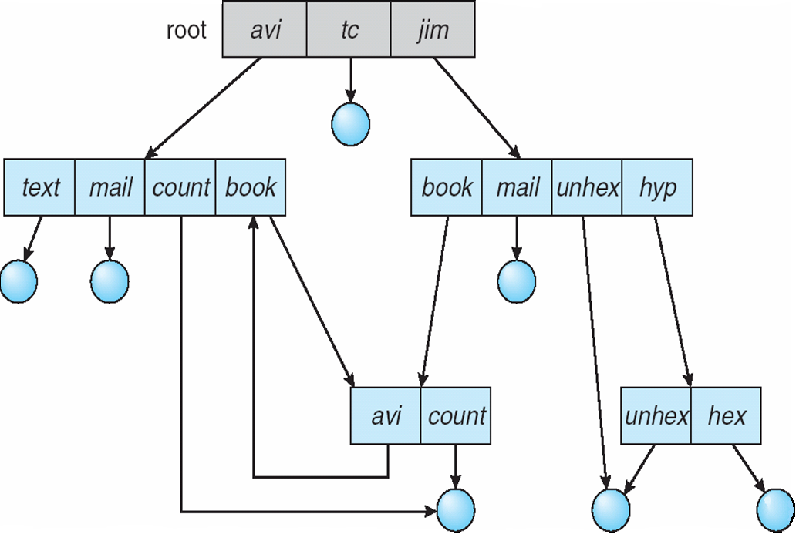
General Graph Directory
How do we guarantee no cycles?
  Allow only links to file not subdirectories
  Garbage collection
  Every time a new link is added use a cycle detection
  algorithm to determine whether it is OK

Slide 21
File System Mounting
A file system must be mounted before it can be accessed
A unmounted file system (i.e. Fig. 11-11(b)) is mounted at a mount point

Slide 22
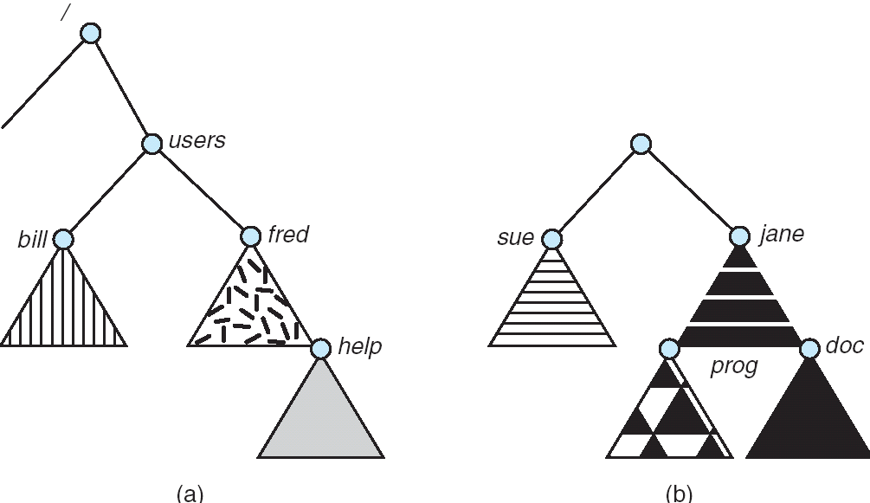
(a) Existing. (b) Unmounted Partition

Slide 23
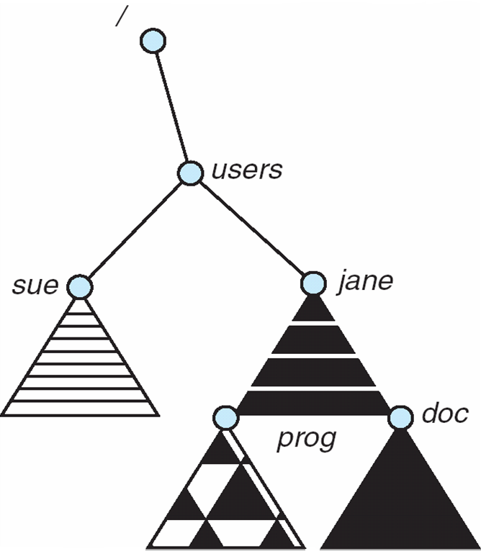
Mount Point

Slide 24
File Sharing
Sharing of files on multi-user systems is desirable
Sharing may be done through a protection scheme
On distributed systems, files may be shared across a network
Network File System (NFS) is a common distributed file-sharing method
User IDs identify users, allowing permissions and protections to be per-user
Group IDs allow users to be in groups, permitting group access rights
File Sharing – Multiple Users

Slide 25
File Sharing – Remote File Systems
Uses networking to allow file system access between systems
  Manually via programs like FTP
  Automatically, seamlessly using distributed file systems
  Semi automatically via the world wide web
Client-server model allows clients to mount remote file systems from servers
  Server can serve multiple clients
  Client and user-on-client identification is insecure or complicated
  NFS is standard UNIX client-server file sharing protocol
  CIFS is standard Windows protocol
  Standard operating system file calls are translated into remote calls
Distributed Information Systems (distributed naming services) such as LDAP, DNS, NIS, Active Directory implement unified access to information needed for remote computing

Slide 26
File Sharing – Failure Modes
Remote file systems add new failure modes, due to network failure, server failure
Recovery from failure can involve state information about status of each remote request
Stateless protocols such as NFS include all information in each request, allowing easy recovery but less security

Slide 27
File Sharing – Consistency Semantics
Consistency semantics specify how multiple users are to access a shared file simultaneously
  Similar to Ch 7 process synchronization algorithms
    Tend to be less complex due to disk I/O and network latency (for remote file systems
  Andrew File System (AFS) implemented complex remote file sharing semantics
  Unix file system (UFS) implements:
    Writes to an open file visible immediately to other users of the same open file
    Sharing file pointer to allow multiple users to read and write concurrently
  AFS has session semantics
    Writes only visible to sessions starting after the file is closed

Slide 28
Chapter 2 : File System Implementation
File-System Structure
File-System Implementation
Directory Implementation
Allocation Methods
Free-Space Management

Slide 29
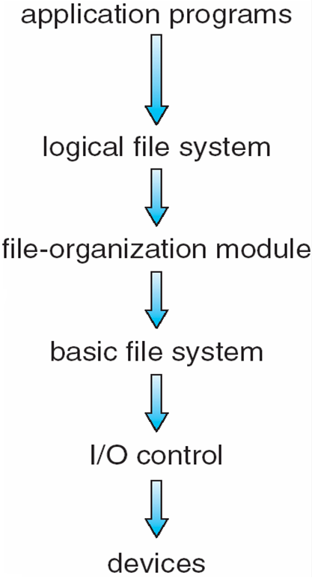
File-System Structure
File structure
  Logical storage unit
  Collection of related information
File system organized into layers
File system resides on secondary storage (disks)
  Provides efficient and convenient access to disk by allowing data to be stored, located retrieved easily
File control block – storage structure consisting of information about a file
Device driver controls the physical device
Layered File System

Slide 30
File-System Implementation
Boot control block contains info needed by system to boot OS from that volume
Volume control block contains volume details
Directory structure organizes the files
Per-file File Control Block (FCB) contains many details about the file

Slide 31
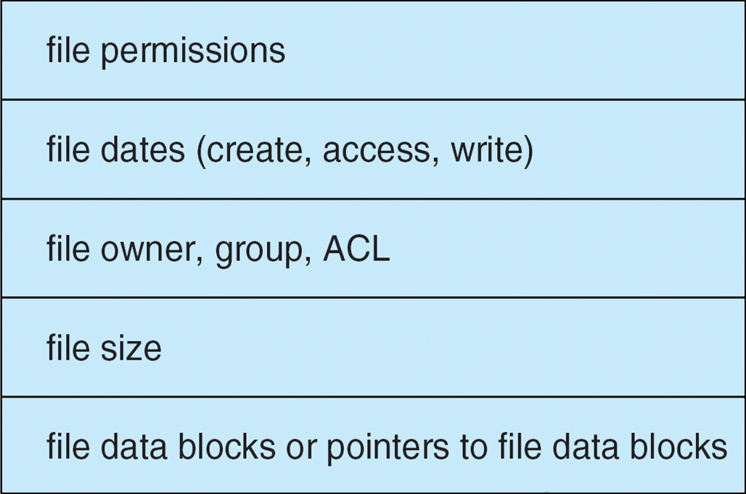
A Typical File Control Block

Slide 32
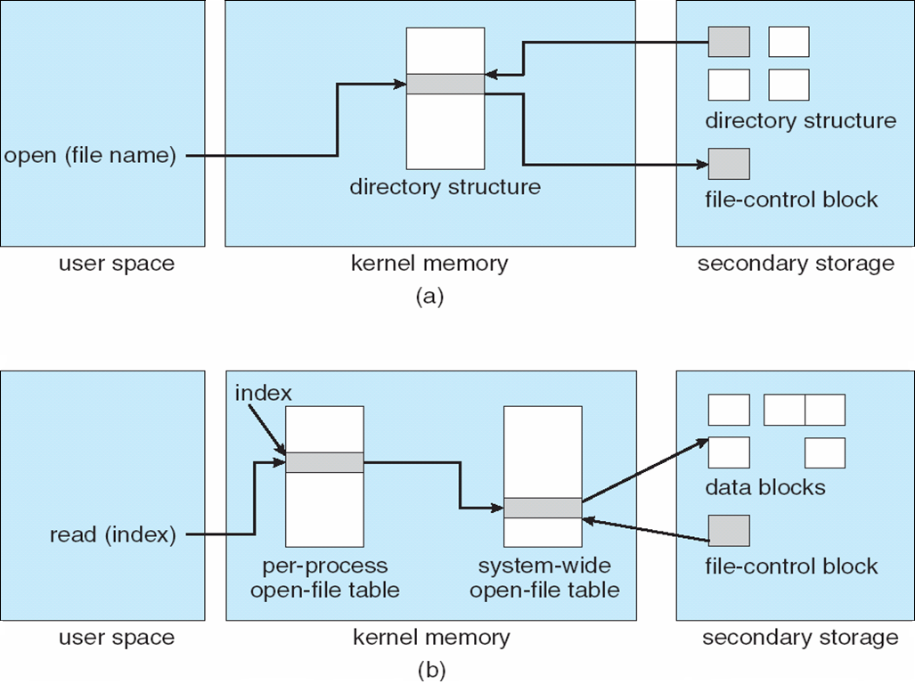
In-Memory File System Structures
opening a file.

Slide 33
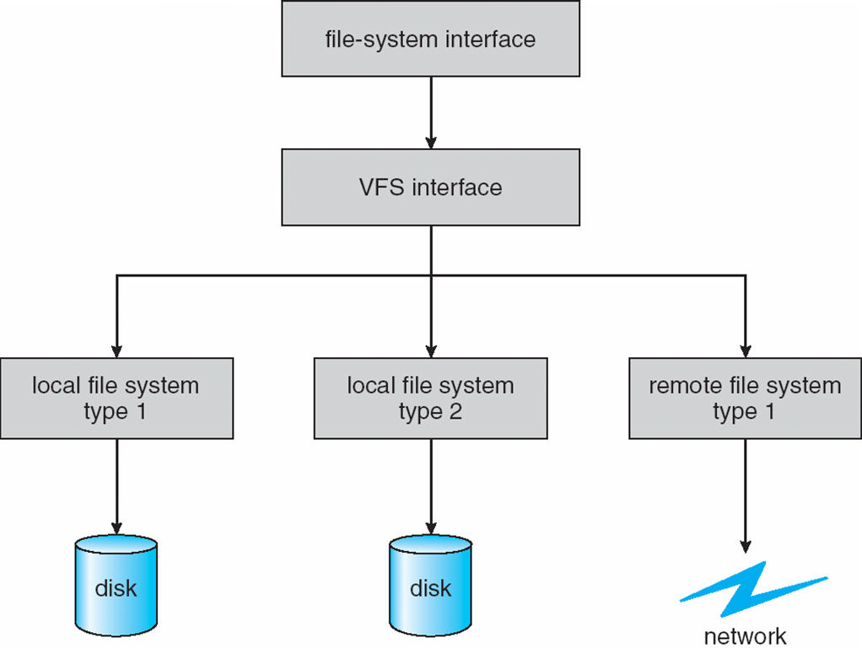
Virtual File Systems
Virtual File Systems (VFS) provide an object-oriented way of implementing file systems.
VFS allows the same system call interface (the API) to be used for different types of file systems.
The API is to the VFS interface, rather than any specific type of file system.
Schematic View of Virtual File System

Slide 34
Directory Implementation
Linear list of file names with pointer to the data blocks.
  simple to program
  time-consuming to execute
Hash Table – linear list with hash data structure.
  decreases directory search time
  collisions – situations where two file names hash to the same location
  fixed size

Slide 35
Allocation Methods
An allocation method refers to how disk blocks are allocated for files:
Contiguous allocation
Linked allocation
Indexed allocation

Slide 36
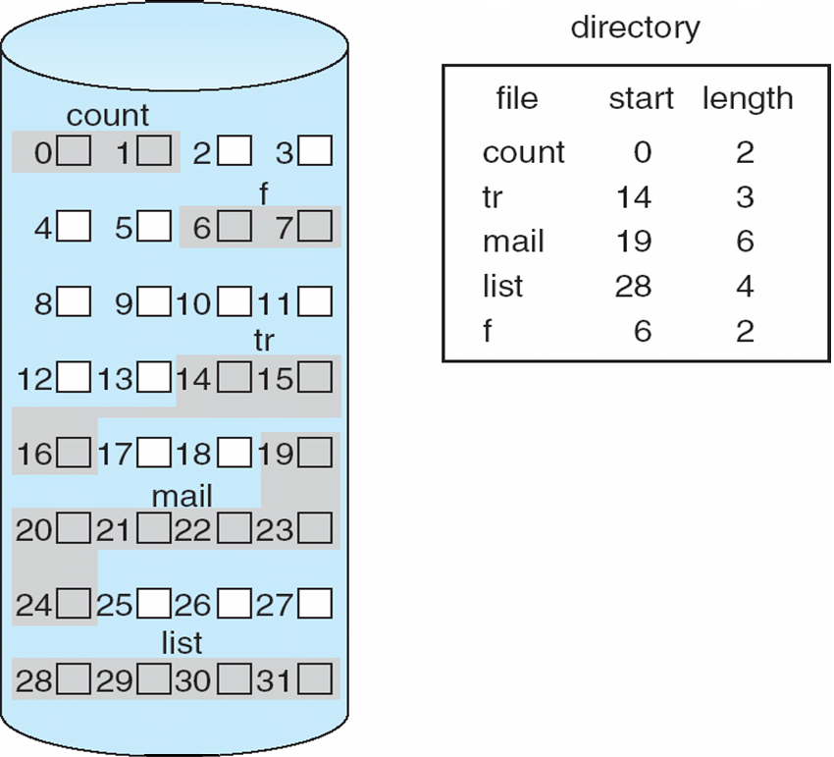
Contiguous Allocation
Each file occupies a set of contiguous blocks on the disk
Simple – only starting location (block #) and length (number of blocks) are required
Random access
Wasteful of space (dynamic storage-allocation problem)
Files cannot grow
Mapping from logical to physical
  Block to be accessed = ! + starting address
  Displacement into block = R
Q
LA/512
R
Contiguous Allocation of Disk Space

Slide 37
Extent-Based Systems
Many newer file systems (I.e. Veritas File System) use a modified contiguous allocation scheme
Extent-based file systems allocate disk blocks in extents
An extent is a contiguous block of disks
  Extents are allocated for file allocation
  A file consists of one or more extents

Slide 38
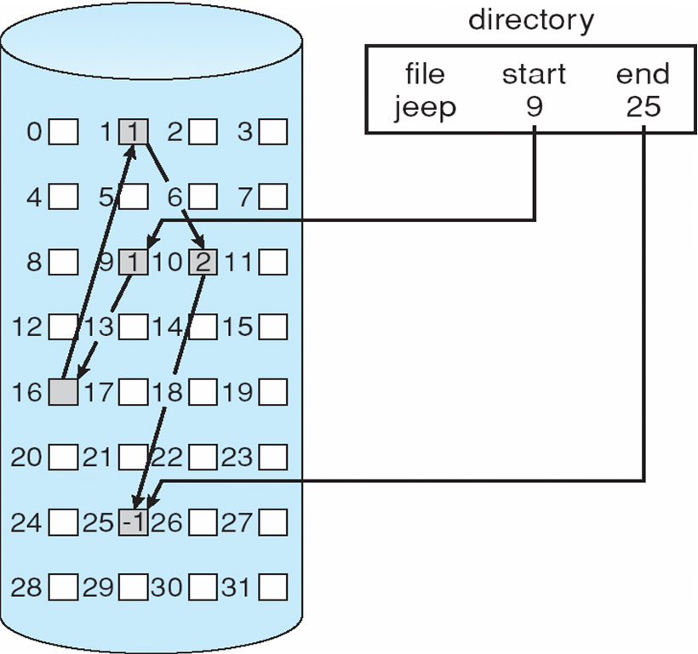
Linked Allocation
Each file is a linked list of disk blocks: blocks may be scattered anywhere on the disk.
Simple – need only starting address
Free-space management system – no waste of space
No random access
Mapping
  Block to be accessed is the Qth block in the linked chain of blocks representing the file.
  Displacement into block = R + 1
File-allocation table (FAT) – disk-space allocation used by MS-DOS and OS/2.
block =
pointer
Q
LA/511
R
Linked Allocation

Slide 39
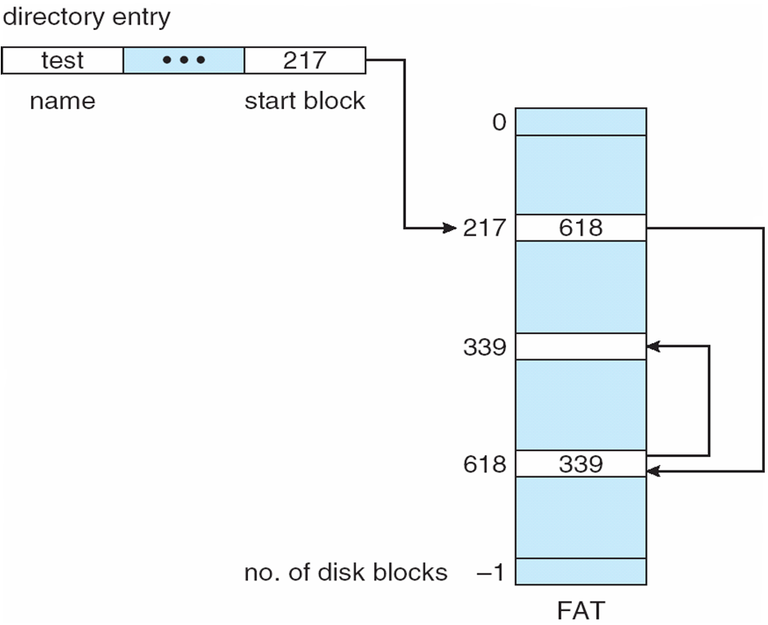
File-Allocation Table

Slide 40
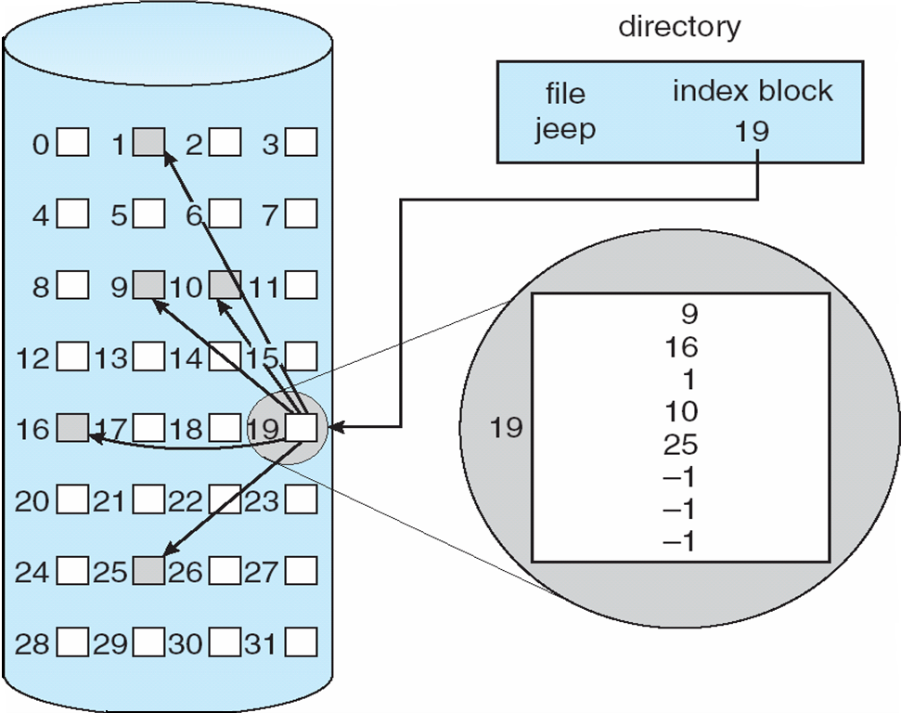
Indexed Allocation
Brings all pointers together into the index block
Logical view
Need index table
Random access
Dynamic access without external fragmentation, but have overhead of index block
Mapping from logical to physical in a file of maximum size of 256K words and block size of 512 words. We need only 1 block for index table
index table
Example of Indexed Allocation

Slide 41
Indexed Allocation (Cont.)
Q = displacement into index table
R = displacement into block
Mapping from logical to physical in a file of unbounded length (block size of 512 words)
Linked scheme – Link blocks of index table (no limit on size)
Q
LA/512
R
Q₁
LA / (512 x 511)
R₁
  Q₁ = block of index table
  R₁ is used as follows:
Q₂
R₁ / 512
R₂
  Q₂ = displacement into block of index table
  R₂ displacement into block of file:

Slide 42
Indexed Allocation – Mapping (Cont.)
Two-level index (maximum file size is 512³)
Q₁
LA / (512 x 512)
R₁
  Q₁ = displacement into outer-index
  R₁ is used as follows:
Q₂

R₁ / 512
R₂
  Q₂ = displacement into block of index table
  R₂ displacement into block of file:
outer-index
index table
file
Indexed Allocation – Mapping

Slide 43
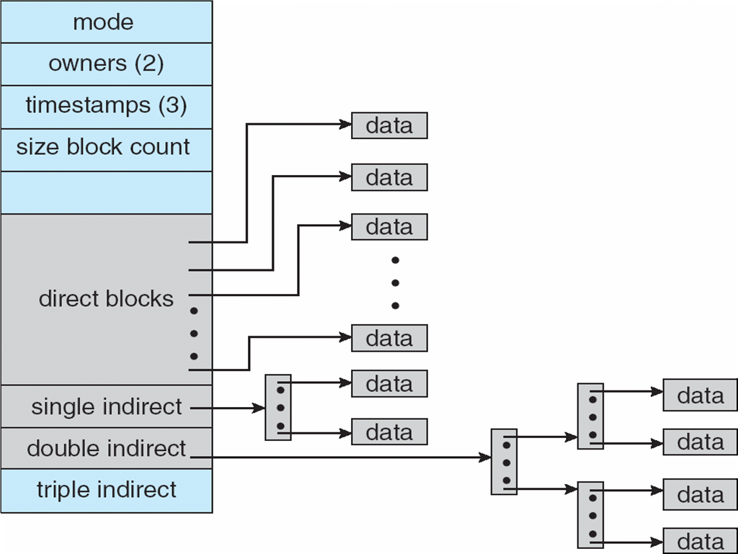
Combined Scheme: UNIX UFS (4K bytes per block)

Slide 44
Free-Space Management
Bit vector (n blocks)
Bit map requires extra space
  Example:
block size = 2¹² bytes
disk size = 2³⁰ bytes (1 gigabyte)
n = 2³⁰/2¹² = 2¹⁸ bits (or 32K bytes)
Easy to get contiguous files
Linked list (free list)
  Cannot get contiguous space easily
  No waste of space
Grouping
Counting
0
1
2
n-1
…
0 ⇒ block[i] free
1 ⇒ block[i] occupied
bit[i] =

Block number calculation
(number of bits per word) *
(number of 0-value words) +
offset of first 1 bit

Slide 45
Free-Space Management (Cont.)
Need to protect:
  Pointer to free list
  Bit map
    Must be kept on disk
    Copy in memory and disk may differ
    Cannot allow for block[i] to have a situation where bit[i] = 1 in memory and bit[i] = 0 on disk
  Solution:
    Set bit[i] = 1 in disk
    Allocate block[i]
    Set bit[i] = 1 in memory

Slide 46
Directory Implementation
Linear list of file names with pointer to the data blocks
  simple to program
  time-consuming to execute
Hash Table – linear list with hash data structure
  decreases directory search time
  collisions – situations where two file names hash to the same location
  fixed size

Slide 47
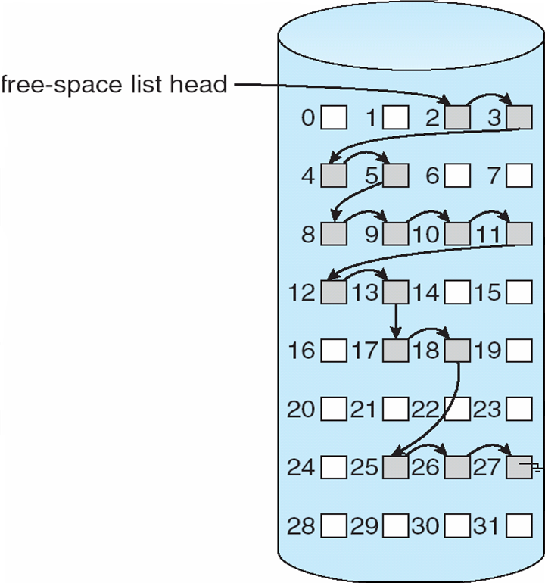
Linked Free Space List on Disk

Slide 48
Chapter 3: Mass-Storage Systems
Overview of Mass Storage Structure
Disk Structure
Disk Attachment
Disk Scheduling
Disk Management

Slide 49
Overview of Mass Storage Structure
Magnetic disks provide bulk of secondary storage of modern computers
  Drives rotate at 60 to 200 times per second
  Transfer rate is rate at which data flow between drive and computer
  Positioning time (random-access time) is time to move disk arm to desired cylinder (seek time) and time for desired sector to rotate under the disk head (rotational latency)
  Head crash results from disk head making contact with the disk surface
    That’s bad
Disks can be removable
Drive attached to computer via I/O bus
  Busses vary, including EIDE, ATA, SATA, USB, Fibre Channel, SCSI
  Host controller in computer uses bus to talk to disk controller built into drive or storage array

Slide 50
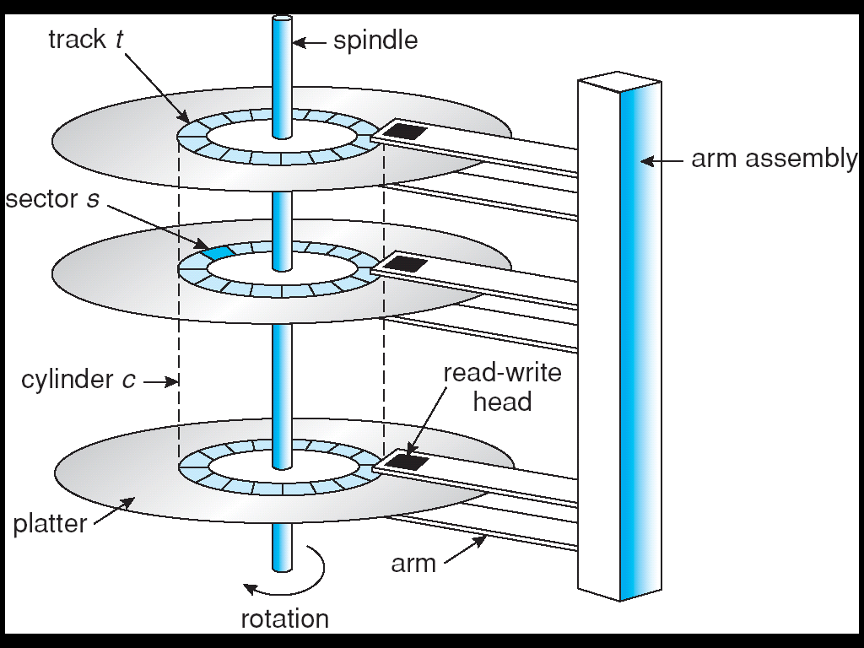
Overview of Mass Storage Structure (Cont)
Magnetic tape
  Was early secondary-storage medium
  Relatively permanent and holds large quantities of data
  Access time slow
  Random access ~1000 times slower than disk
  Mainly used for backup, storage of infrequently-used data, transfer medium between systems
  Kept in spool and wound or rewound past read-write head
  Once data under head, transfer rates comparable to disk
  20-200GB typical storage
  Common technologies are 4mm, 8mm, 19mm, LTO-2 and SDLT
Moving-head Disk Mechanism

Slide 51
Disk Structure
Disk drives are addressed as large 1-dimensional arrays of logical blocks, where the logical block is the smallest unit of transfer
The 1-dimensional array of logical blocks is mapped into the sectors of the disk sequentially
  Sector 0 is the first sector of the first track on the outermost cylinder
  Mapping proceeds in order through that track, then the rest of the tracks in that cylinder, and then through the rest of the cylinders from outermost to innermost

Slide 52
Disk Attachment
Host-attached storage accessed through I/O ports talking to I/O busses
SCSI itself is a bus, up to 16 devices on one cable, SCSI initiator requests operation and SCSI targets perform tasks
  Each target can have up to 8 logical units (disks attached to device controller
FC is high-speed serial architecture
  Can be switched fabric with 24-bit address space – the basis of storage area networks (SANs) in which many hosts attach to many storage units
  Can be arbitrated loop (FC-AL) of 126 devices

Slide 53
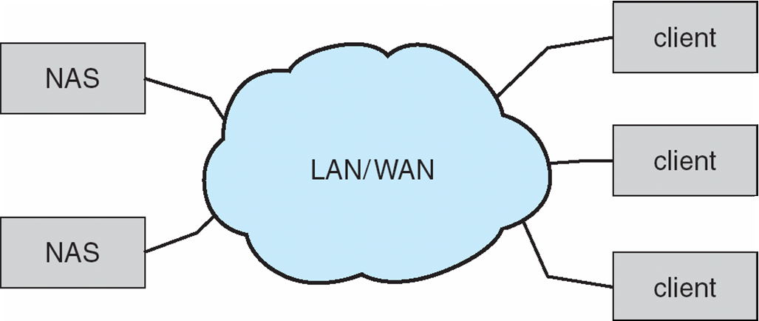
Network-Attached Storage
Network-attached storage (NAS) is storage made available over a network rather than over a local connection (such as a bus)
NFS and CIFS are common protocols
Implemented via remote procedure calls (RPCs) between host and storage
New iSCSI protocol uses IP network to carry the SCSI protocol

Slide 54
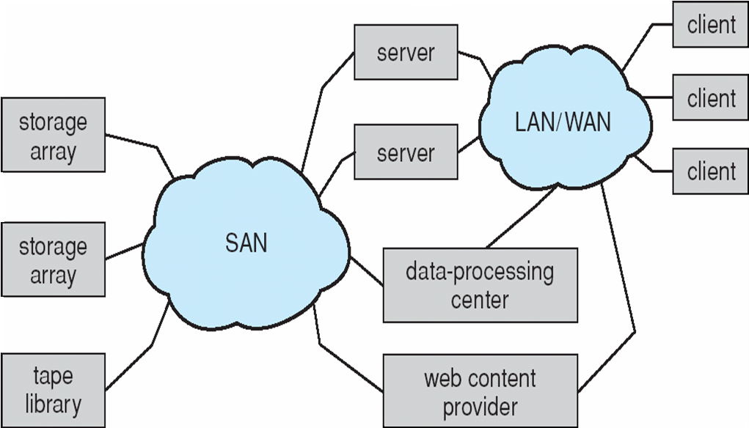
Storage Area Network
Common in large storage environments (and becoming more common)
Multiple hosts attached to multiple storage arrays - flexible

Slide 55
Disk Scheduling
The operating system is responsible for using hardware efficiently — for the disk drives, this means having a fast access time and disk bandwidth
Access time has two major components
  Seek time is the time for the disk are to move the heads to the cylinder containing the desired sector
  Rotational latency is the additional time waiting for the disk to rotate the desired sector to the disk head
Minimize seek time
Seek time ≈ seek distance
Disk bandwidth is the total number of bytes transferred, divided by the total time between the first request for service and the completion of the last transfer
Several algorithms exist to schedule the servicing of disk I/O requests
We illustrate them with a request queue (0-199)
98, 183, 37, 122, 14, 124, 65, 67
Head pointer 53

Slide 56
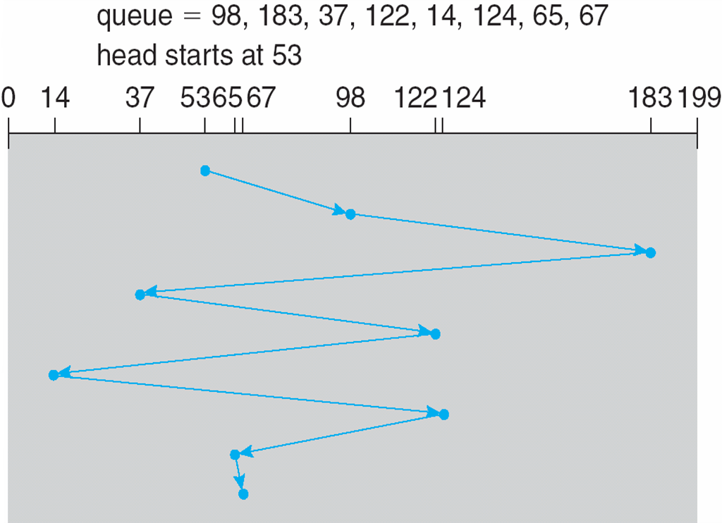
FCFS
Illustration shows total head movement of 640 cylinders

Slide 57
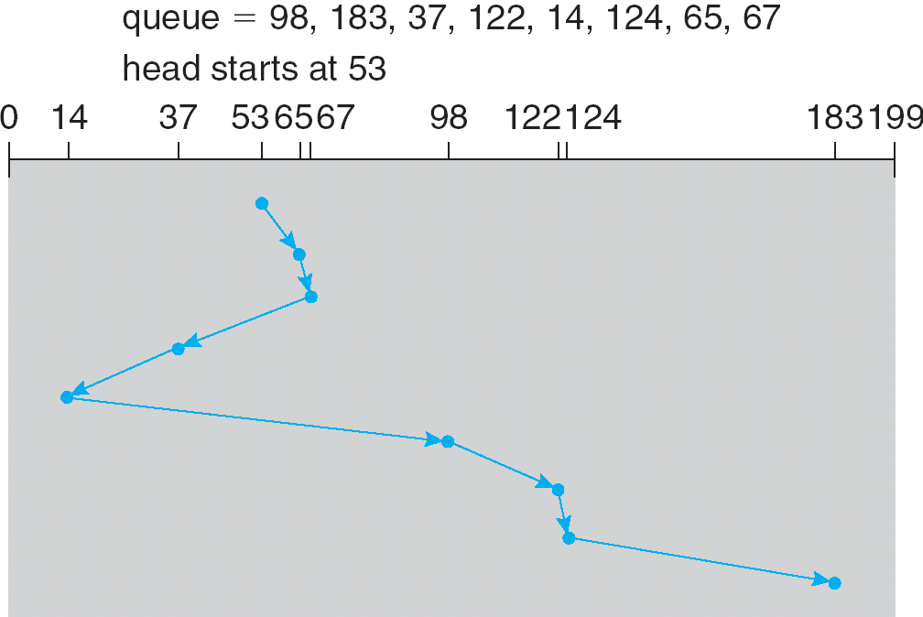
SSTF
Selects the request with the minimum seek time from the current head position
SSTF scheduling is a form of SJF scheduling; may cause starvation of some requests
Illustration shows total head movement of 236 cylinders

Slide 58
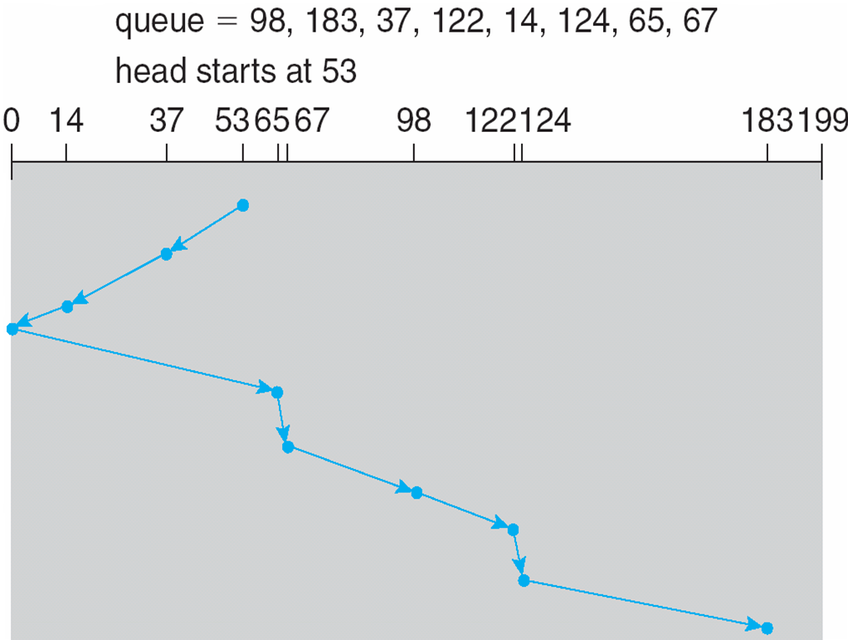
SCAN
The disk arm starts at one end of the disk, and moves toward the other end, servicing requests until it gets to the other end of the disk, where the head movement is reversed and servicing continues.
SCAN algorithm Sometimes called the elevator algorithm
Illustration shows total head movement of 208 cylinders

Slide 59
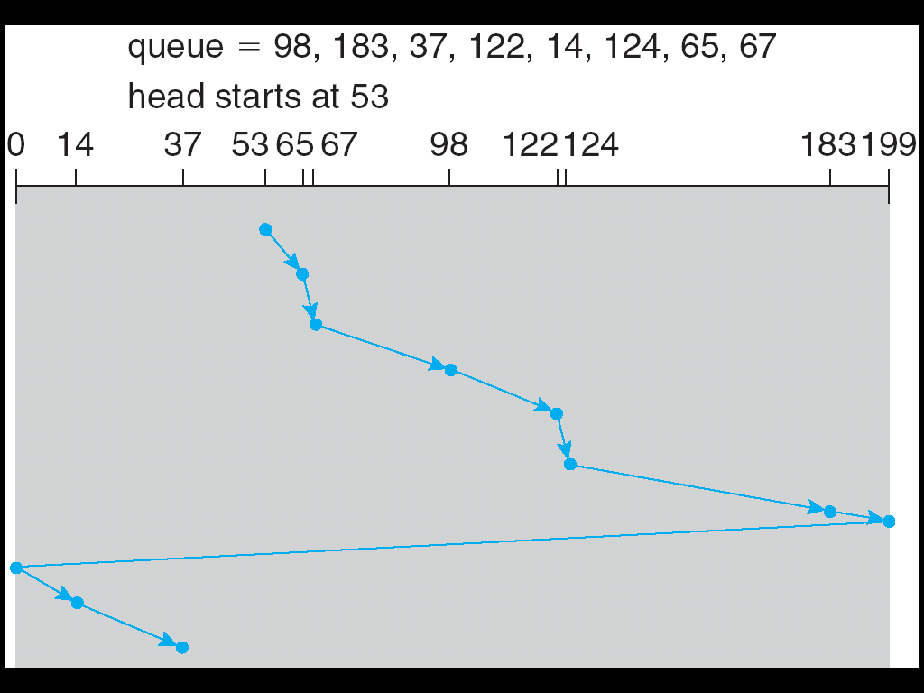
C-SCAN
Provides a more uniform wait time than SCAN
The head moves from one end of the disk to the other, servicing requests as it goes
  When it reaches the other end, however, it immediately returns to the beginning of the disk, without servicing any requests on the return trip
Treats the cylinders as a circular list that wraps around from the last cylinder to the first one

Slide 60
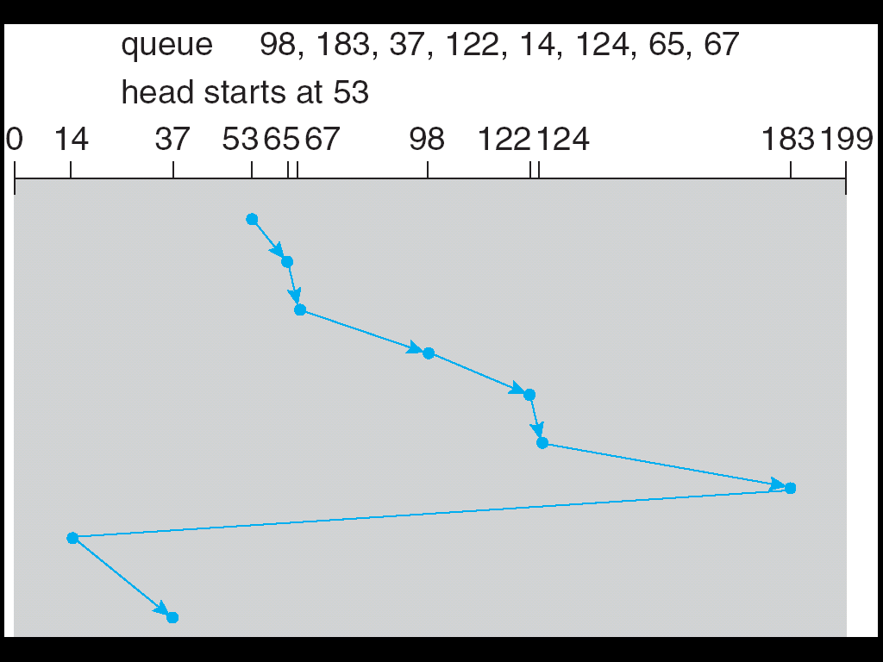
C-LOOK
Version of C-SCAN
Arm only goes as far as the last request in each direction, then reverses direction immediately, without first going all the way to the end of the disk

Slide 61
Selecting a Disk-Scheduling Algorithm
SSTF is common and has a natural appeal
SCAN and C-SCAN perform better for systems that place a heavy load on the disk
Performance depends on the number and types of requests
Requests for disk service can be influenced by the file-allocation method
The disk-scheduling algorithm should be written as a separate module of the operating system, allowing it to be replaced with a different algorithm if necessary
Either SSTF or LOOK is a reasonable choice for the default algorithm

Slide 62
Disk Management
Low-level formatting, or physical formatting — Dividing a disk into sectors that the disk controller can read and write
To use a disk to hold files, the operating system still needs to record its own data structures on the disk
  Partition the disk into one or more groups of cylinders
  Logical formatting or “making a file system”
  To increase efficiency most file systems group blocks into clusters
    Disk I/O done in blocks
    File I/O done in clusters
Boot block initializes system
  The bootstrap is stored in ROM
  Bootstrap loader program
Methods such as sector sparing used to handle bad blocks

Slide 63
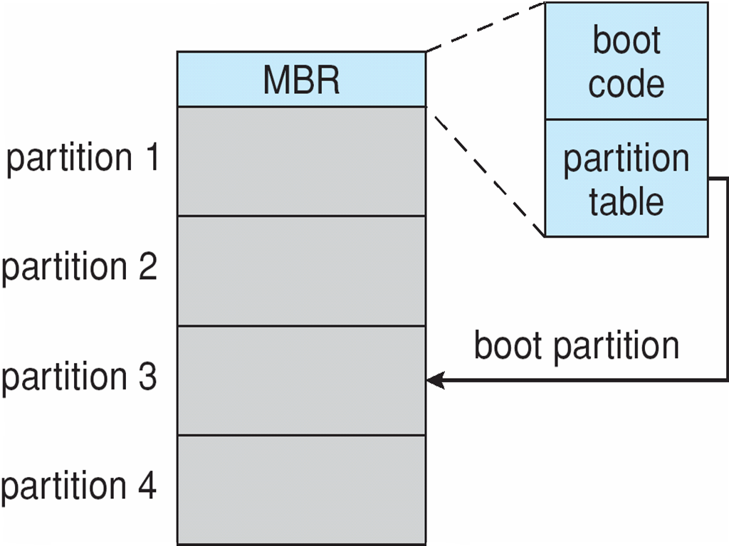
Booting from a Disk in Windows 2000

